Slide 1
Typhoon Sensei
NVIDIA TEAM
Notes:
Hello, everyone! Welcome to our presentation. I’m Yelim Kim from NVIDIA Team, ”Typhoon Sensei." Today, we are excited to share our project.

Slide 2
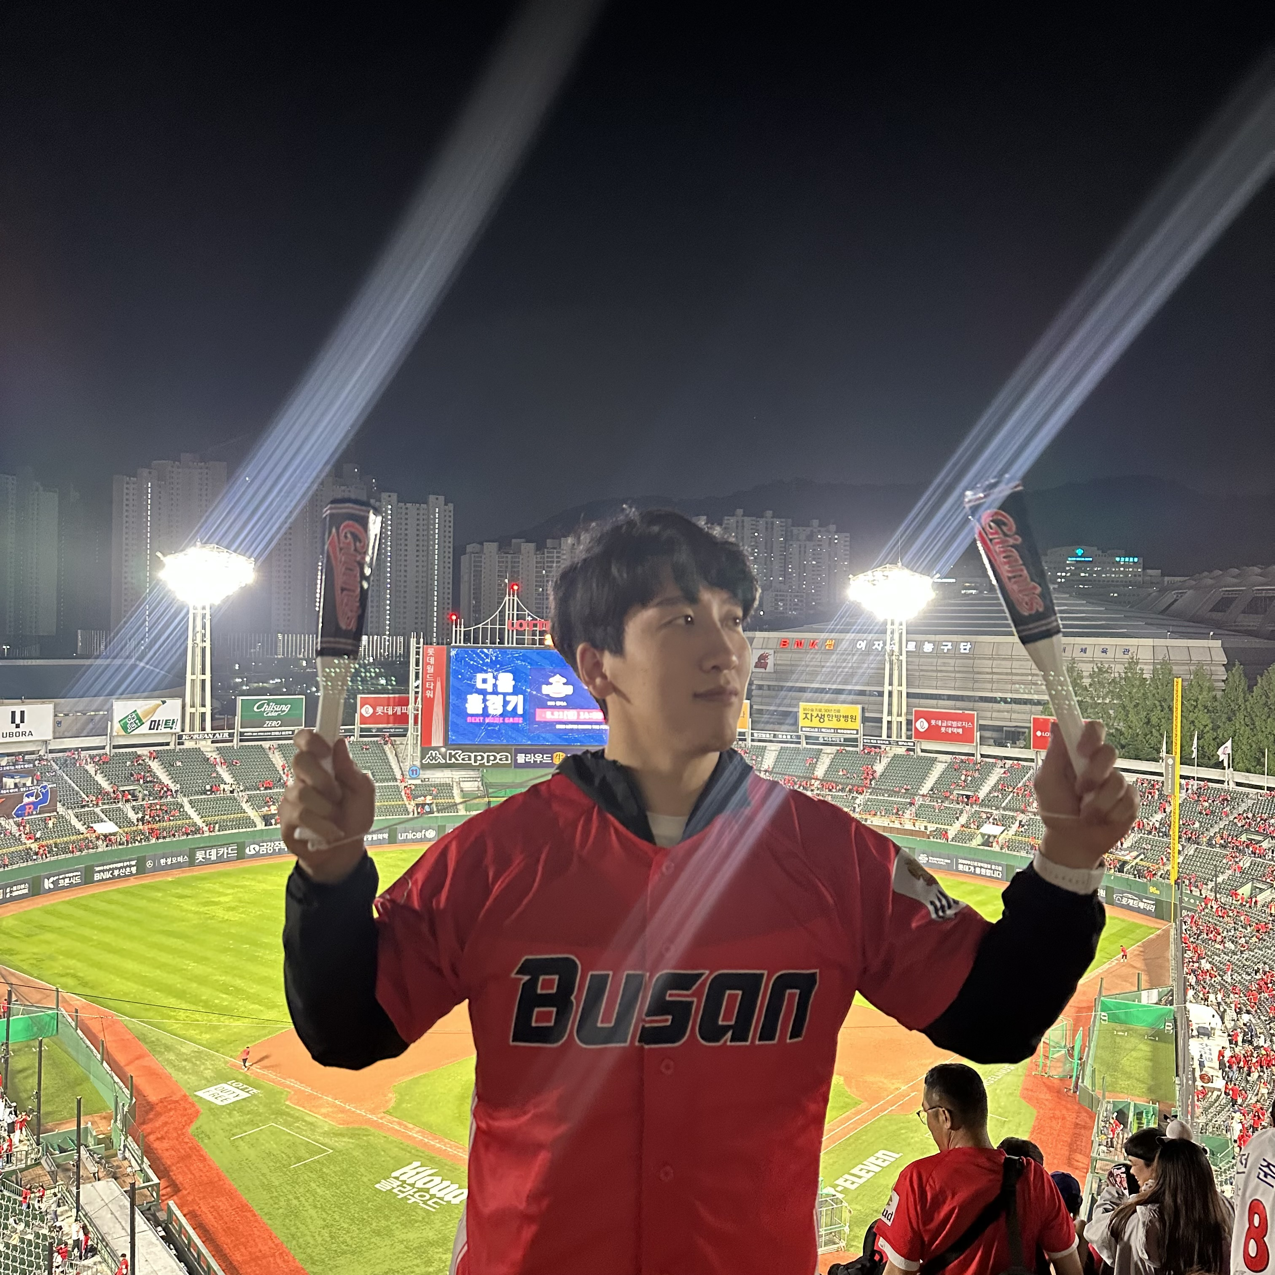
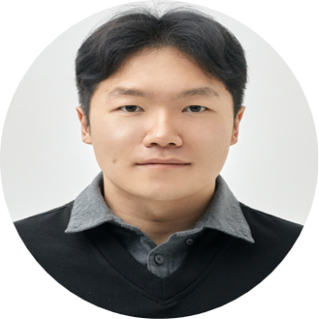


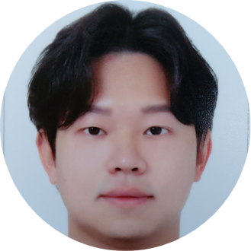
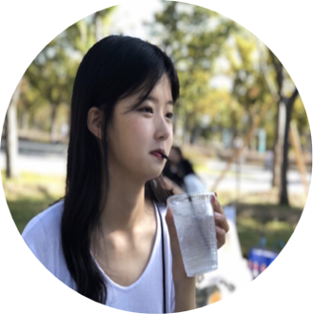
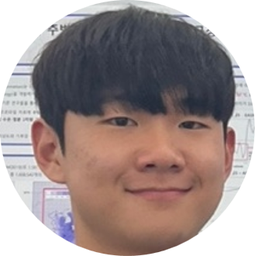
Our Members
Jiho Ko
Changi Lee
Jinwan Joo
Yelim Kim
Graduate student at Pohang University of Science and Technology (POSTECH)’s Climate System Lab.
Graduate student at Chonnam National University’s Climate Science Lab. My major is education, but I interested in climate and atmospheric science.
Student at Kyungpook National University’s Mesoscale Weather Extremes Lab.
Research Assistant at Seoul National University's Weather and Climate Dynamics Lab,
Gunwoo Do
Dasom Ryu
Haedo Baek
Graduate student at Korea Maritime & Ocean University’s Climate Science Lab.
Graduate student at Korea Maritime & Ocean University’s Climate Science Lab.
Graduate student at Chungnam National University`s Ocean Climate Dynamics LAB.
Notes:
Before we begin, we would like to introduce our team members / who worked together on this project.

Slide 3
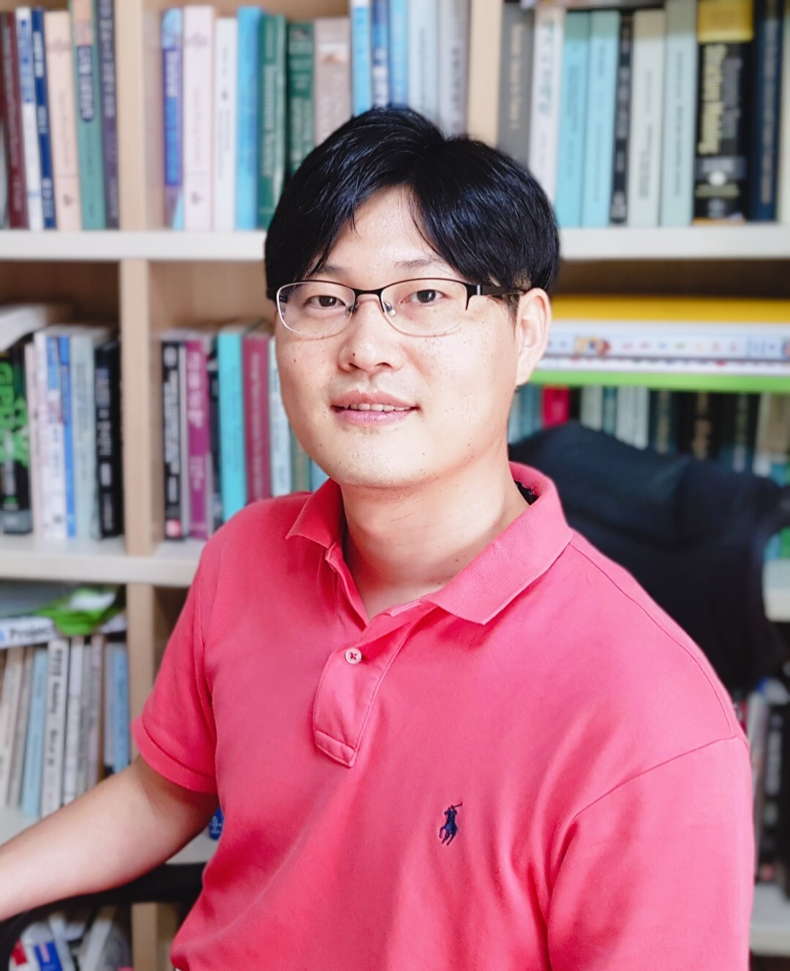
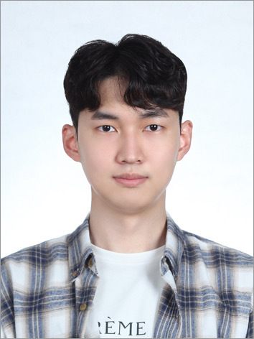

Our Mentors
Hyungon Ryu
Daewon Kim
Song chi-oh
NVIDIA
Machine learning engineer, works in HanwhaSystems/ICT
Machine Learning Engineer
現 Chart studio CEO
前 Linewalks(現 Kakao healthcare)
Aswinkumar
Jeff Adie
Juntao Yang
NVIDIA
NVIDIA
NVIDIA
Notes:
And also our mentors / who supported us throughout this project.

Slide 4
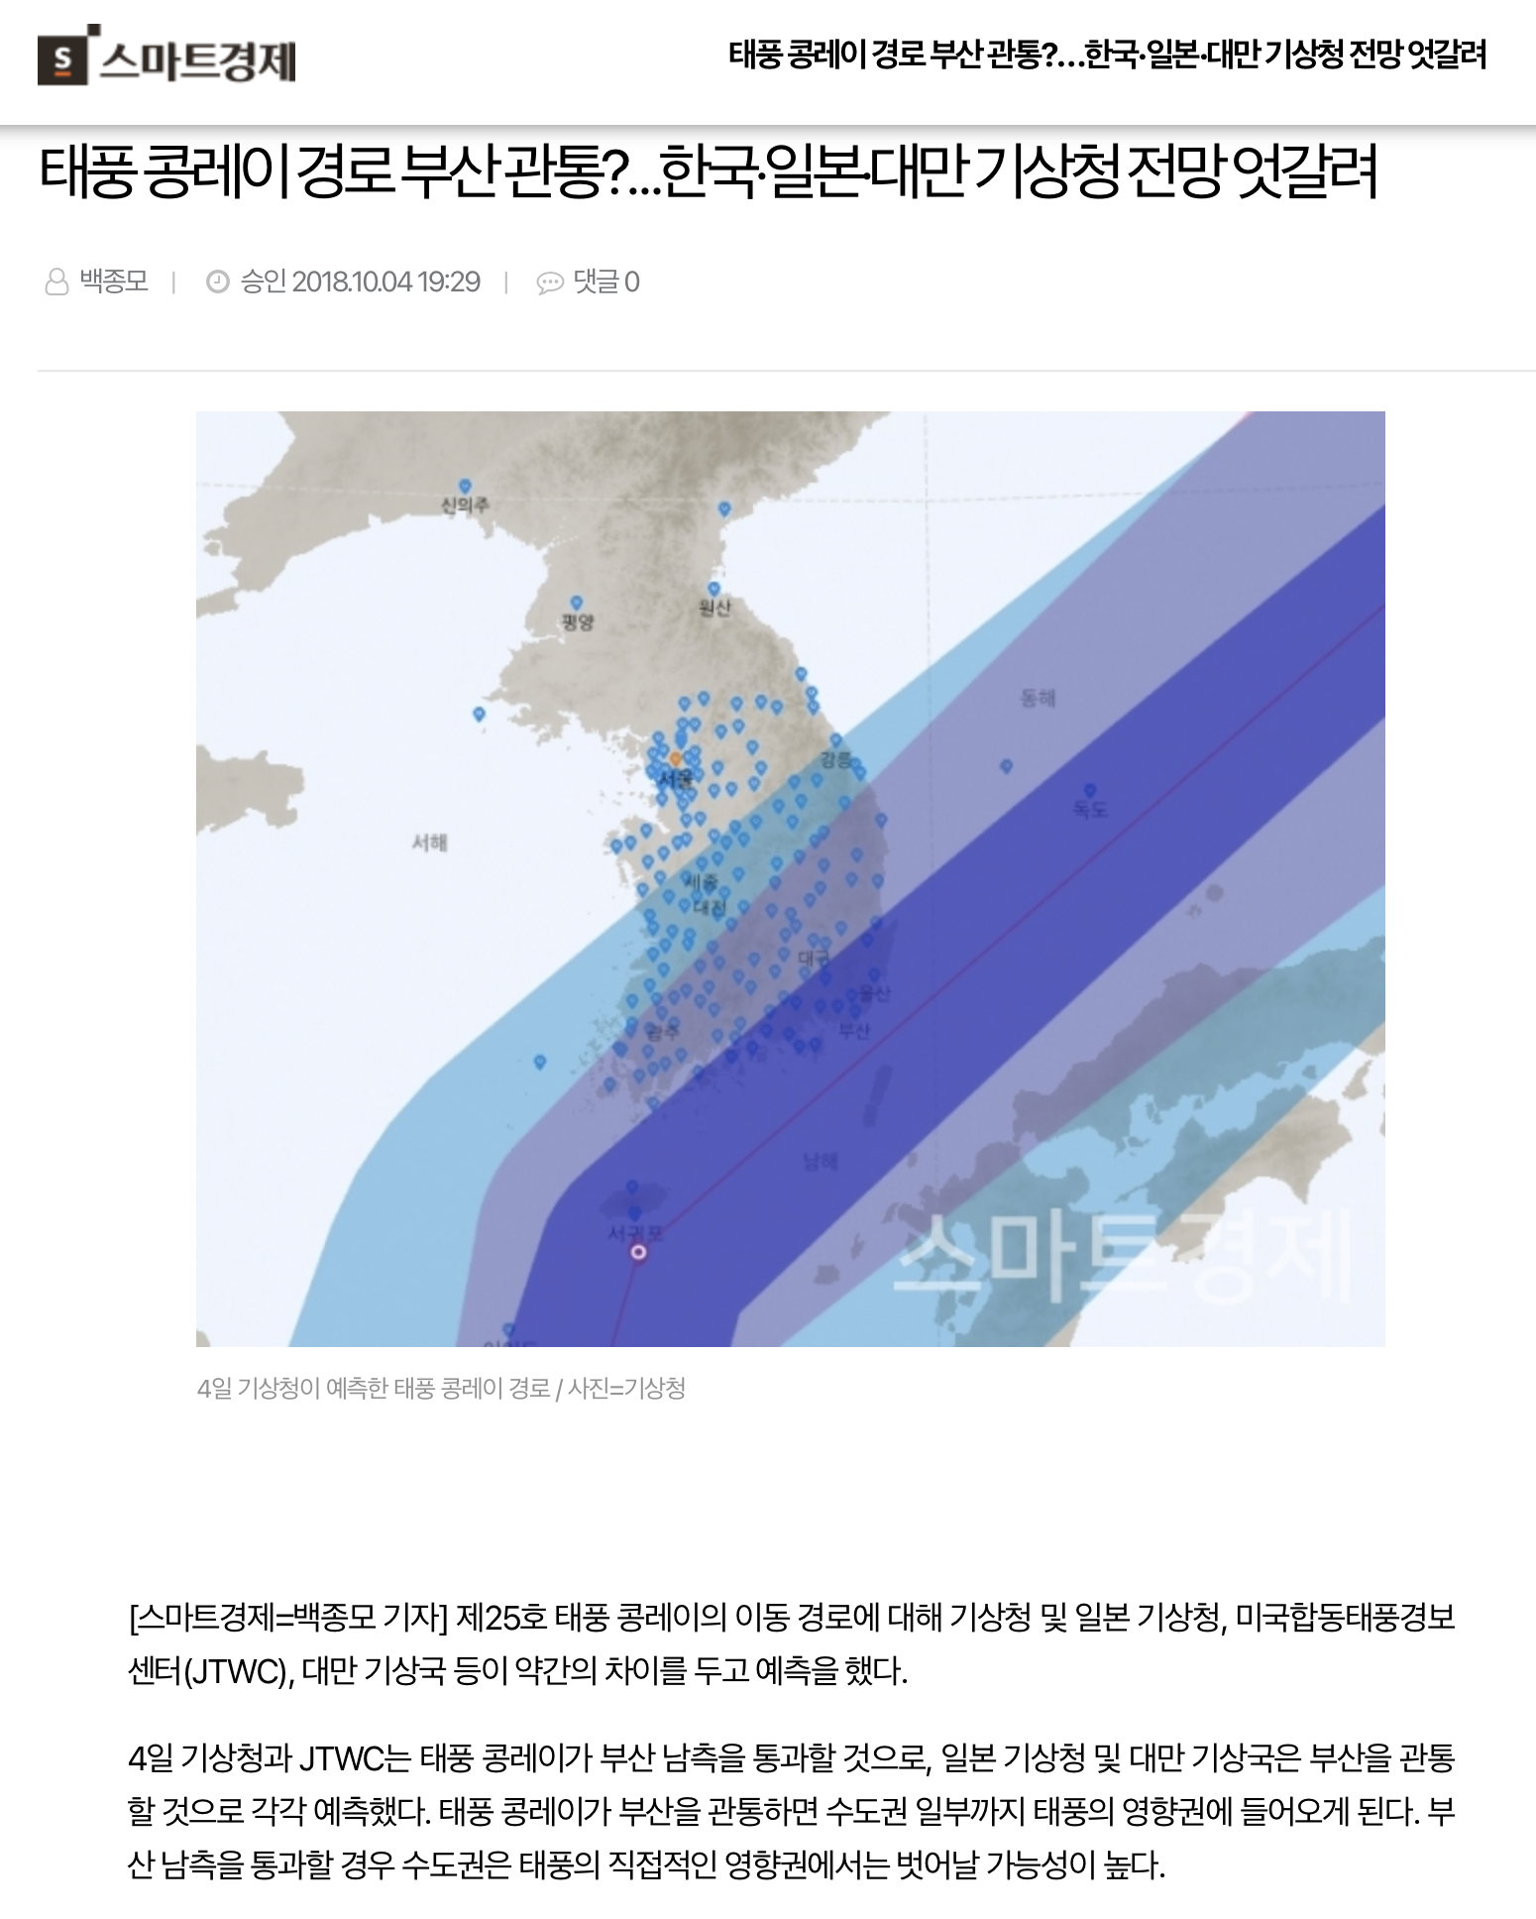
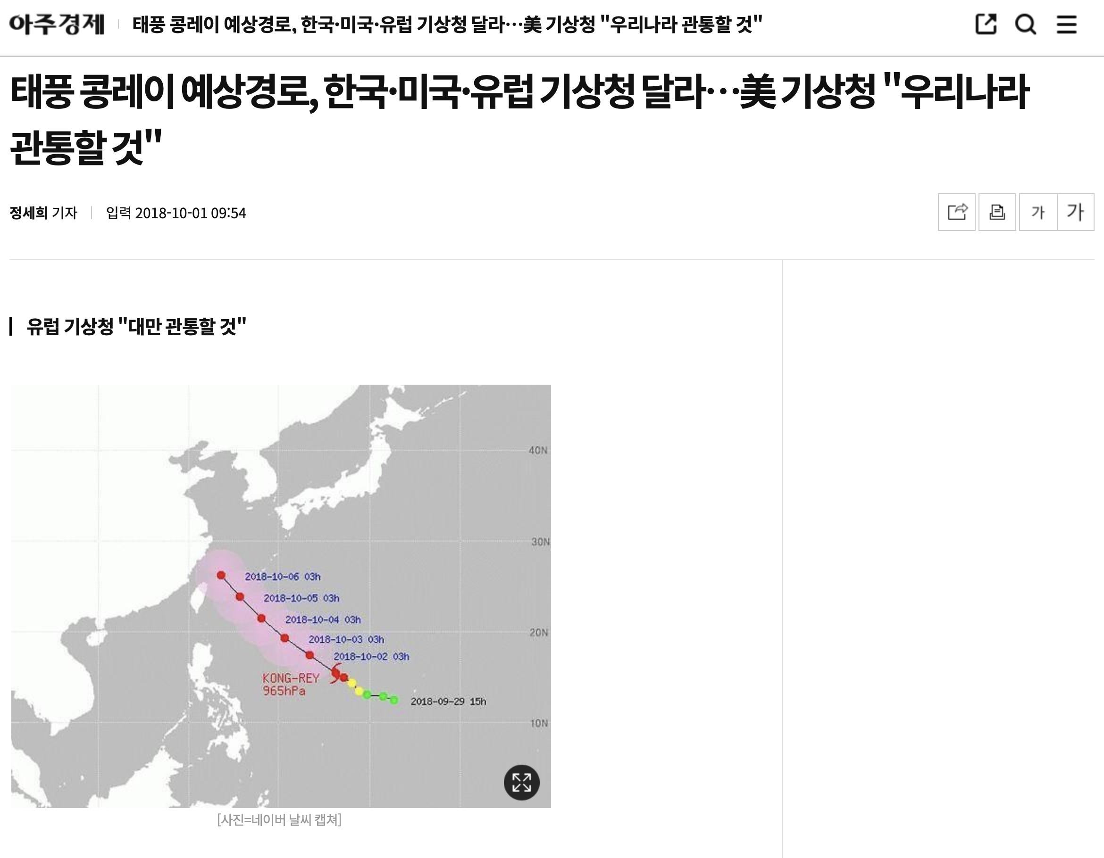
Socially Arisen Issue
Prediction from ECMWF about the projected path of Typhoon Kongrei was inaccurate
ECMWF is the European Centre for Medium-Range Weather Forecasts.
This model is considered the best-performing numerical model.
Notes:
The expected path of typhoon 'Kongrei' was a major (소사이어털) issue indeed.
This was due to the fact that the ECMWF, which was considered / the best-performing model in the field, had produced / inaccurate results for the prediction of Kongrei’s path.
Our team was eager to solve this problem.

Slide 5
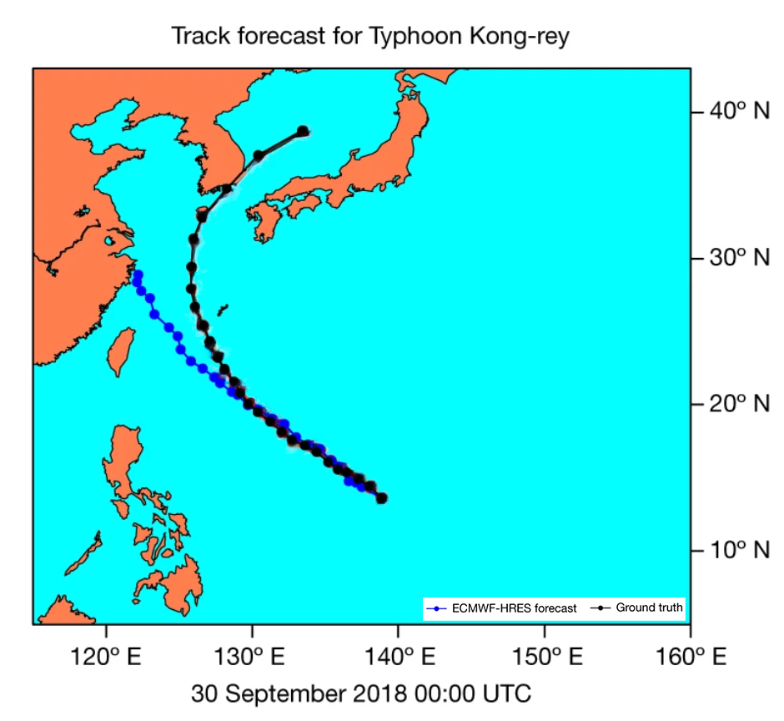
Our Hackathon Topic
Predict Typhoon Kongrei and potentially other typhoons using FCN
Notes:
The blue points on the figure represent / the expected path produced by the ECMWF model, while the black points indicate the actual path taken by the kongrey. As one can notice, significant 디스크레판시스 existed between the results, and this caused 언프레세덴티드 damages taken by both Korea and Japan.
/ This caught our attention and/ led us to choose our subject for the hackathon / to be
(클릭)‘the prediction of the path of typhoon Kongrei using FCN model.

Slide 6
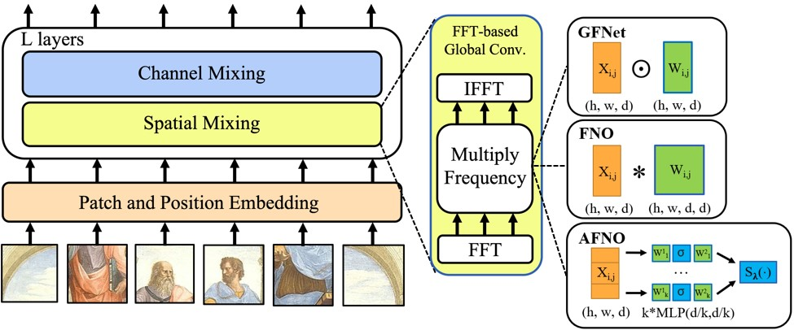
Our Hackathon Topic
FCN model structure——AFNO
Notes:
To start with, we'd like to briefly브리플리 introduce the FCN model. This model uses AFNO for predictions, and this type of architecture is an / enhanced version of the 비전 Transformer model. The mixed operations are composed of / global convolutions and are / 이팩티블리 implemented through the 퓨리에 transform.

Slide 7
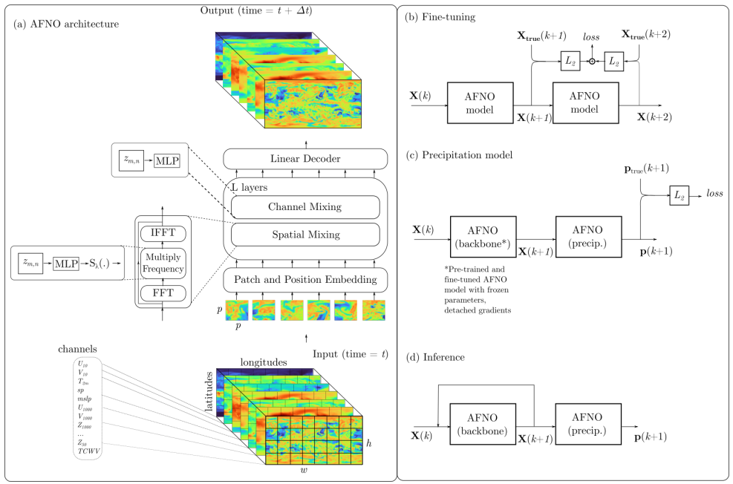
Our Hackathon Topic
FCN model structure
Notes:
The FCN model begins with projecting the input variables from ERA5 dataset on a 720*1440 latitude 롱지튜드 grid onto a 2D patch grid. Each patch is represented by a d-dimensional token, and the patch sequence and location encoding are passed together onto the AFNO layer. The training process of FCN is carried out gradually, and the configuration of the FCN model we received will be explained in detail in a future slide.

Slide 8
What is Our Goal?
Exploring how we can leverage our background knowledge effectively.
Meteorological research, front-end, deep-learning training
The model is already developed, but training it within the limited time is unfeasible.
How can we improve this situation?
Is there any possibility of applying the model for typhoon forecasts?
Notes:
Our goal for the project was to make the most / out of our knowledge. Many students in our group had conducted meteorological미디올로이컬 research and had background knowledge of front-end programming as well. Most importantly, we all wanted to improve the model through the two weeks of training. Therefore, we tried to materialize메테이얼라이즈 it through two key ideas. They were,
(클릭)
1. The model is already developed but training it within the limited time is unfeasible. How can we improve this situation?
(클릭)
2. Is there any possibility of applying the model for typhoon forecasts?
In the following slides, we explained the problem we encountered on each topic and suggested a solution if there was one.

Slide 9
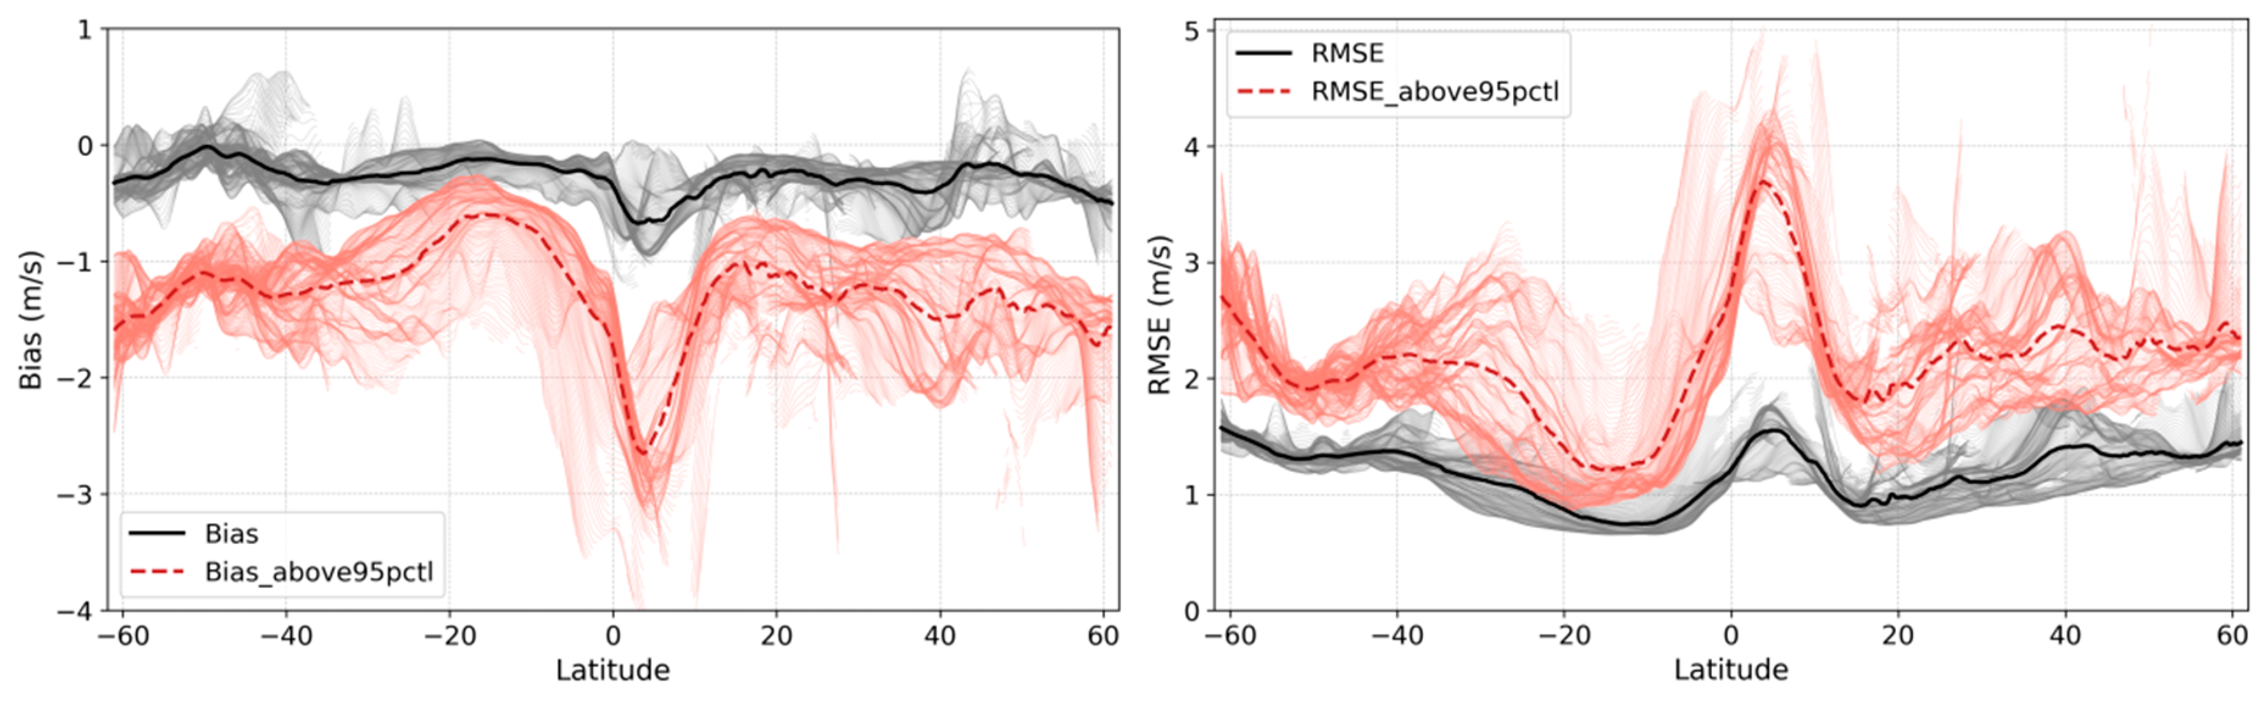
The model is already developed, but training it within the limited time is unfeasible.
How can we improve this situation?
The problems we encountered & proposed solutions
1. Insufficient Data for forecasting
- underestimated for the wind speed values
Campos, R.M.; Gramcianinov, C.B.; de Camargo, R.; da Silva Dias, P.L. Assessment and Calibration of ERA5 Severe Winds in the Atlantic Ocean Using Satellite Data. Remote Sens. 2022, 14, 4918.
Notes:
the Initial problem is Unsuitable data representation for maximum wind velocity. ERA5 data used is grid data, leading to average value drops. In extreme situations, the difference from the average is significant. Due to the lack of awareness of peak wind speed, danger radius comprehension is challenging, leading to 언더레스티메이팅underestimating wind speed values.
Applying this data to the model / introduces additional prediction difficulties / due to double smoothening.

Slide 10
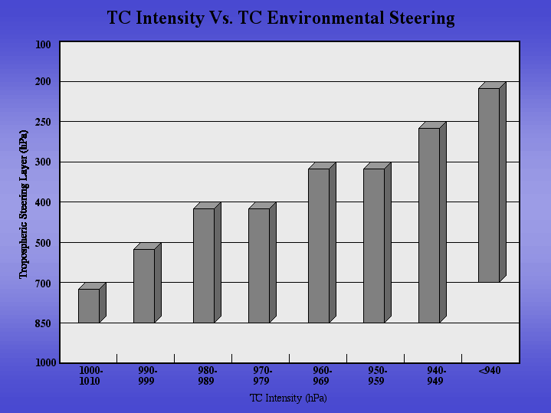
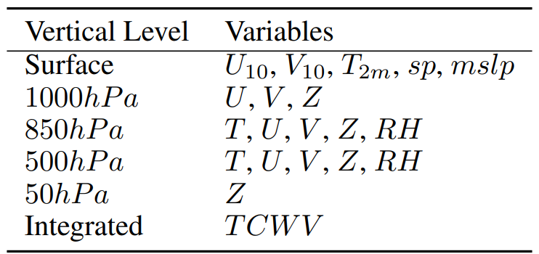
The model is already developed, but training it within the limited time is unfeasible.
How can we improve this situation?
2. limitations of FCN in typhoon forecasting
“FCN is a global data-driven weather forecasting model that provides accurate short to medium range global predictions at 0.25◦ resolution. ”
+ 250hPa T, U, V, Z, RH
Notes:
The second problem was of the / variables that were used during the training of the FCN model. To quote코우트 from Nvidia's official website, FCN is a model that provides global predictions ”
In other words, the FCN model is not a model designed to predict typhoons. We found a problem with this.
(클릭)
As can be seen from the data on the left, variables below at least 200 hPa핵토파스칼 are required.
A way to improve this (클릭) is to delete the variables that are not necessary for typhoon prediction and insert the variables at 250hPa핵토파스칼 that we need as a minimum. However, to train the model with these variables, we judged that it was impossible to finish during the hackathon period and decided to leave it for future research.

Slide 11
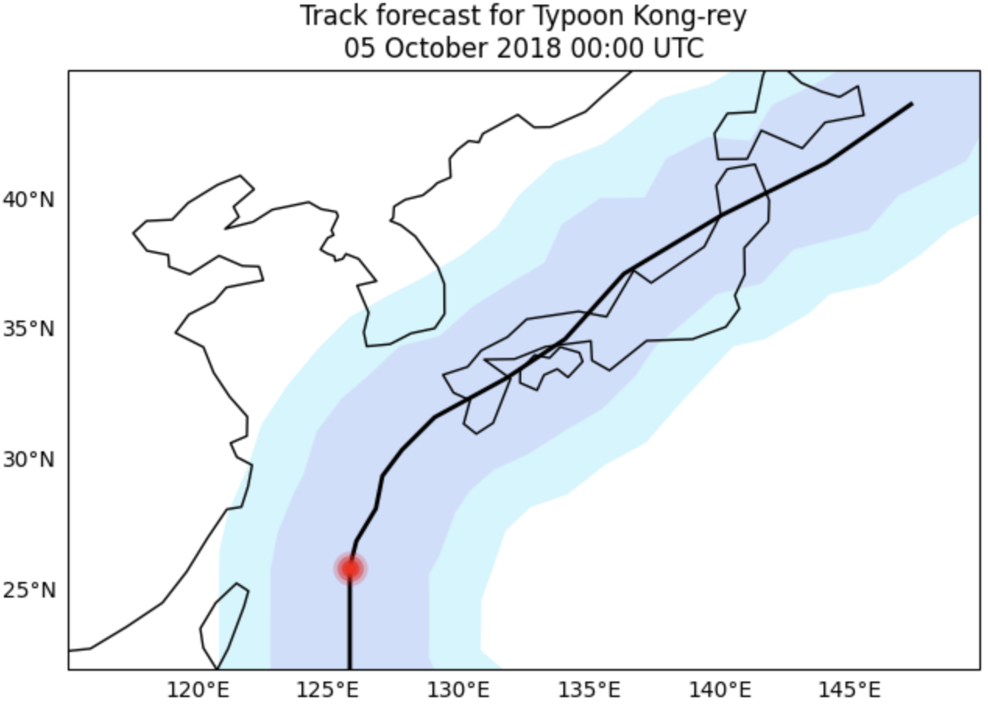

The model is already developed, but training it within the limited time is unfeasible.
How can we improve this situation?
3. Reduce the forecast intervals & increase frequency
“These variables, listed in the table below are sampled from the ERA5 dataset at a temporal resolution of 6 hours.”
Notes:
The third problem is that of the ERA5 dataset. This sentence is also quoted from the ERA5 official website “These variables, are sampled at a temporal resolution of 6 hours.”
The ERA5 dataset, **which FCN used for training**, has data at 6-hour intervals. We judged that this interval was / far too short for forecasting and proposed retraining with a dataset with a shorter time interval as a solution.

Slide 12
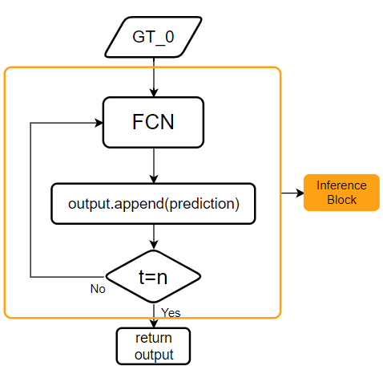
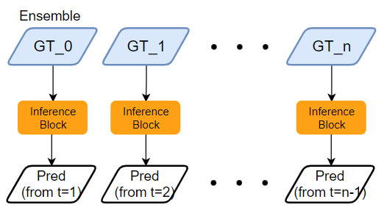
The model is already developed, but training it within the limited time is unfeasible.
How can we improve this situation?
4. Autoregressive Predictions with Ground Truth (GT) Data:
Original
New Structure
Notes:
The FCN model we got at the beginning of the hakathon / has a structure on the left of the slide.
However, we found it challenging to improve the already completed model, so we tried to find another ways to approach it.
As a result, inspired by the feature of FCN - auto-regressive prediction, just here the orange box,
(클릭)
we (devised) a new structure, as shown in the image on the right. We used GT data as input for / each time step in the auto-regressive predictions.
(강조) Also, we combined this approach with the ensemble to present comprehensive results.

Slide 13
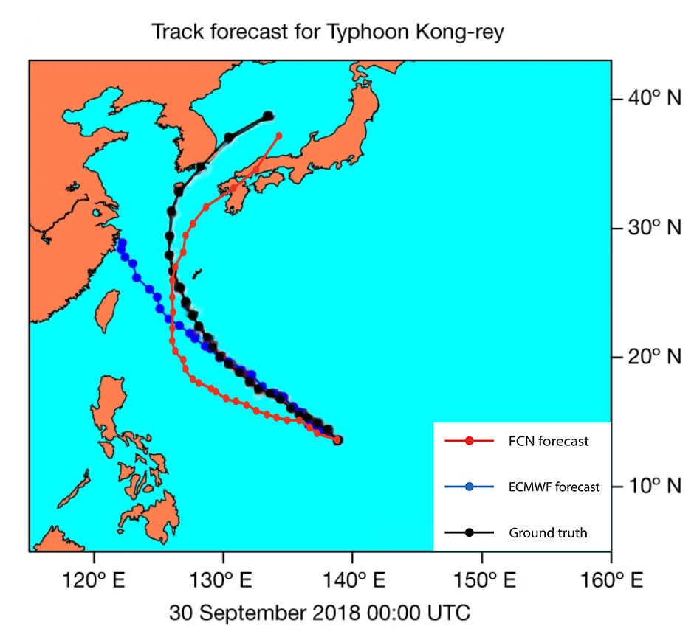
The model is already developed, but training it within the limited time is unfeasible.
How can we improve this situation?
4. Autoregressive Predictions with Ground Truth (GT) Data:
Notes:
The red dots from the figure is our prediction / **without using an ensemble.
Just as we initially aimed for, we have successfully achieved / improved results compared to the existing models.

Slide 14
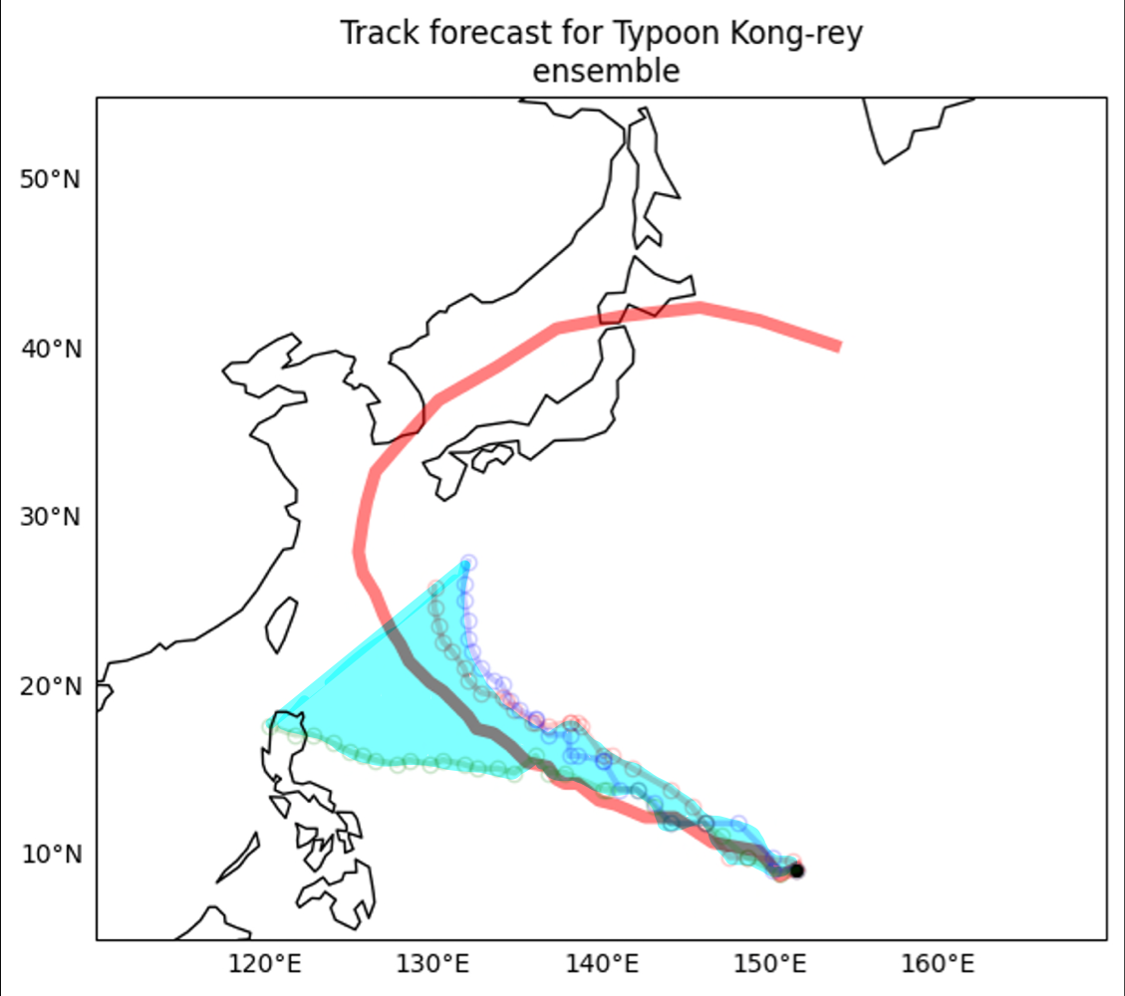
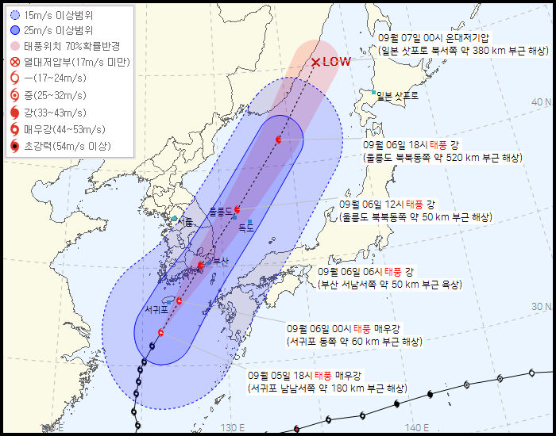
The model is already developed, but training it within the limited time is unfeasible.
How can we improve this situation?
4. Autoregressive Predictions with Ground Truth (GT) Data:
Notes:
Furthermore, we set another ultimate goal / was to achieve results / similar to KMA(those of the meteorological미디얼로지컬 agency).
Therefore, we focused on improving the model and visualizing the results using ansemble, and also we consulted Jeff about the number of ensembles,
and he suggested starting with 10, but due to the OOM issue, we had to limit it to 3 for now.
(클릭)
We have generated results and visualizations using these 3 ensembles, which led to positive outcomes.

Slide 15
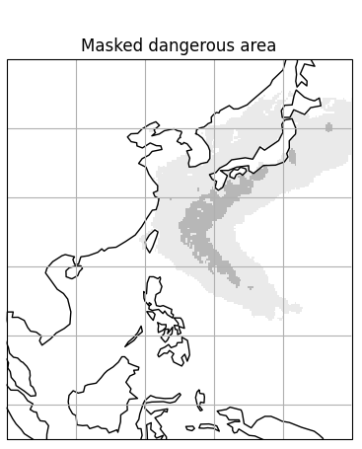
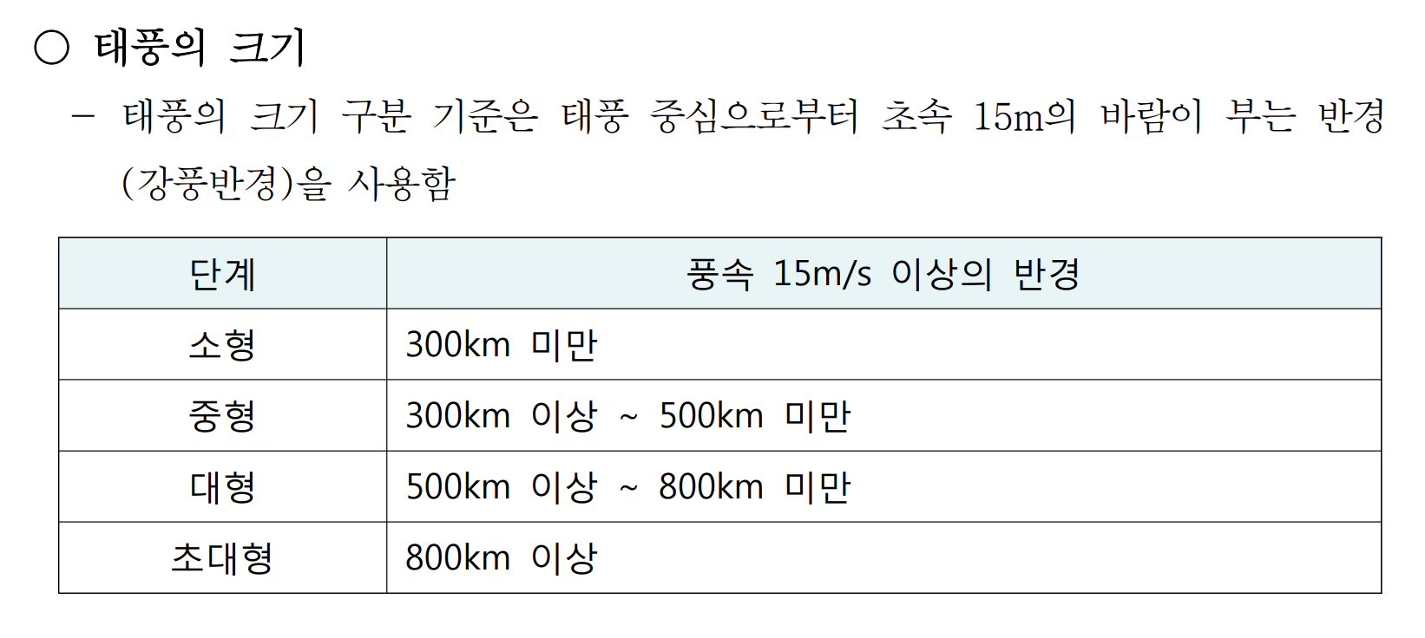
Considering the possibility of applying the model for typhoon forecasts.
The problems we encountered & proposed solutions
1. Selecting the typhoon influence radius
From Typhoon White Book
Notes:
Now I’ll introduce problems related to the topic of creating visualizations and UIs for forecasting. At first, we thought about / how it would affect people / based on the predicted path of the typhoon.
To do so, accurate data on the radius of influence was crucial크류셜. We selected the radius based on the / Typhoon white book.
The figure on the right is the result we made from ERA5 dataset.

Slide 16
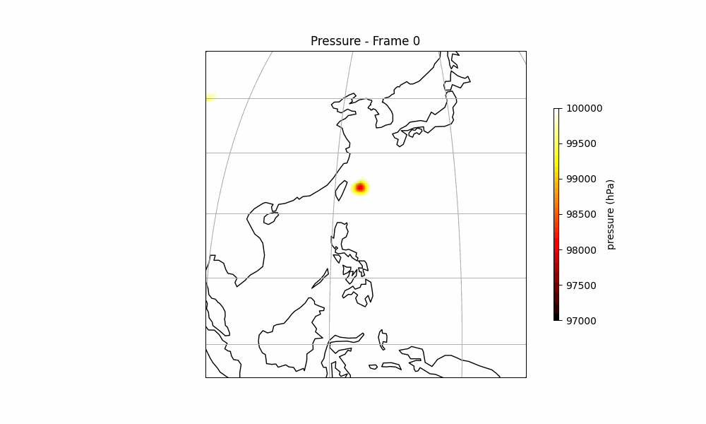
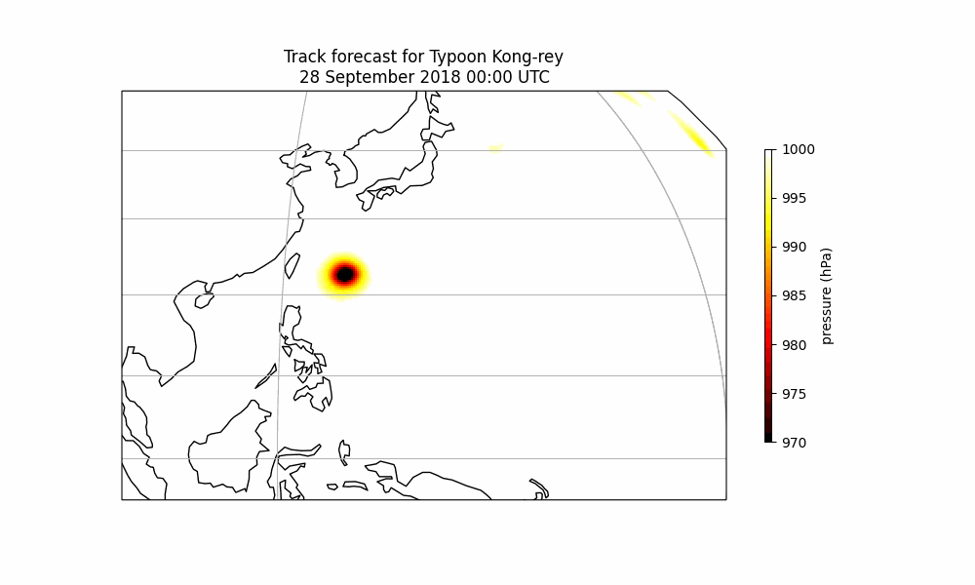
Considering the possibility of applying the model for typhoon forecasts.
2. Processing multiple typhoons
Notes:
The second problem is processing multiple typhoons.
As one can see on the left, when the eye of a typhoon is detected, a typhoon appears on the right side, tracks the eye, and detects another typhoon, leaving the predicted path. So, we specified and classified the location value of the typhoon, and obtained the result shown on the right.

Slide 17
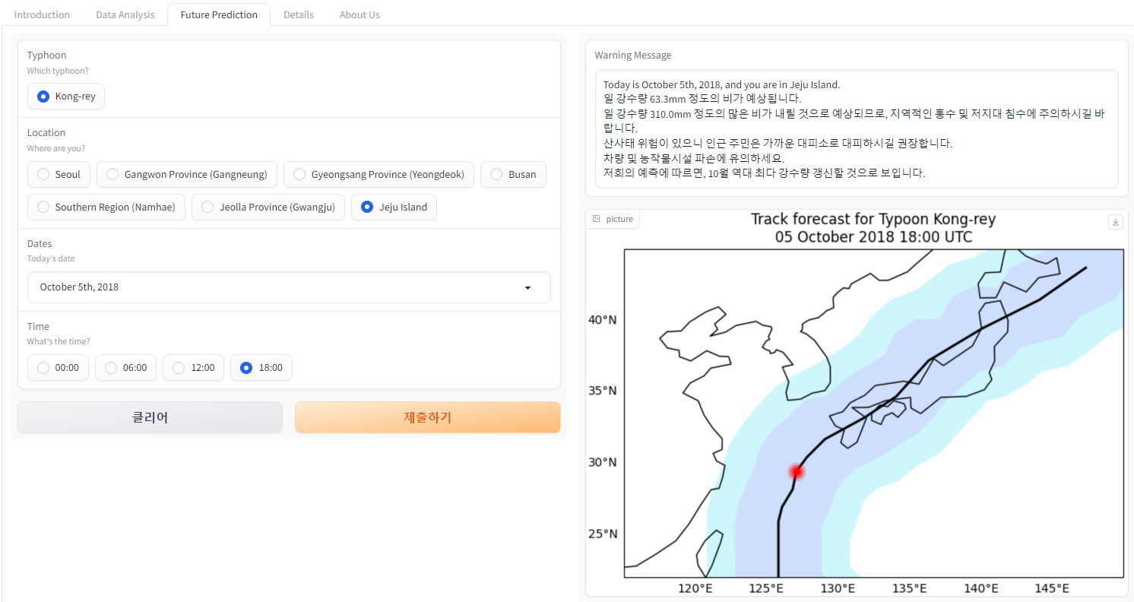
Considering the possibility of applying the model for typhoon forecasts.
3. How to make users use it?
Notes:
Thirdly, we thought about how to make people use this forecast on typhoons.
(클릭)
First, we let the users select the typhoon, date, location, and time. As output values, we gave a warning message on the top to inform people of the size and strength of the incoming typhoon, and what kind of precautions should be taken based on the predicted results. We also added the location of the typhoon in the corresponding time zone and the expected path predicted by the FCN model.

Slide 18
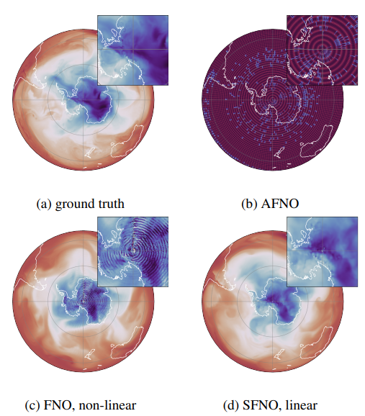
Insights from the Hackathon
Potential research topics for future exploration.
1. AFNO -> SFNO
Bonev, Boris et al. “Spherical Fourier Neural Operators: Learning Stable Dynamics on the Sphere.” ArXiv abs/2306.03838 (2023): n. pag.
Notes:
Now we’ll be discussing insights we gained from the Hackathon.
We gained ideas for / potential research topics / that we may embark on/ in the future.
(클릭)
First, The model we currently utilize is based on the FCN model published in 2022, using AFNO architecture. However, in a research paper published in 2023, SFNO-based FCN was used.
We can't use this code because it hasn't been opened to the public yet, but once it’s released, we’ll be able to get better results using it.

Slide 19
Insights from the Hackathon
Potential research topics for future exploration.
2. Change variables
+ 250hPa T, U, V, Z, RH
Notes:
The next subject is the problem on variables which we mentioned earlier. If we can improve this area and train the model,
we will be able to get better results for typhoon prediction.

Slide 20
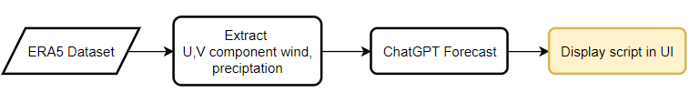
Insights from the Hackathon
Potential research topics for future exploration.
3. enhance UI for real-case
Notes:
The following are possible improvements that can be made to the UI.
Currently, the UI is provided only for Typhoon Kong-Rei, but if you want to receive real-time data, you can create a script using ChatGPT by loading(로우딩) the ERA5 dataset and checking U, V component wind and preciptation.
Following this process, one can receive results for cases using real-time datasets.

Slide 21
Insights from the Hackathon
Ideas on how we can apply the knowledge gained in our respective labs.
현재 딥러닝 모델들의
성능향상을 위한 언급된 개선점
한파 발생 예측에서는 태풍보다
더 나은 예측 성능을 보일 것으로
생각이 들고, 적용해보고 싶다
FCN의 inference 코드를 계속 수정하며 돌리면서 했던 경험을 바탕으로 딥러닝 모델을 활용할 때 어떤식으로 코드를 구성해서 작동시키면 될지에 로직에 대해 이해하게 된 것을 적용시켜 직접 모델을 구현하여 실행하여 현재 도메인에 적용 시키면 될 것이라 생각이 들었습니다.
기후변화 시나리오를 이용한 미래
기후에서의 태풍 진로 및 강도 예측
자연 재해로 인해 발생하는 사회
경제적 피해 예측
UI for Real-case
Notes:
Each team member wrote what kind of research they could do by grafting it to FCN in their own laboratory레보로토리.
I haven’t conducted formal research yet, so I didnt write about the details of the typhoon. However, other students have mentioned their topic in their studies.

Slide 22
Insights from the Hackathon
“One Sentence”
“논문 용 코드”에 대해서 알고
싶지 않았지만 알게 되었다.
조교님 목소리 좀 크게 해주세요ㅎ.ㅎ
신경식 강사님 사진 같이 찍어도 되나요? 아니면 싸인이라도...
연구실을 나와서 좋았다..
오프라인 해커톤 진행 기간 동안
랩미팅 준비하는 기분이었습니다...ㅠ
대전은 노잼도시가 아니다
배고플 때가 없었다
너무 많이 먹었다
Notes:
Lastly, for fun, we included “one sentence” from each of our members.
I wrote, "I didnt want to know about 'code for research papers,' but I ended up discovering it."
I am grateful to the NVIDIA team for providing a comfortable environment to use the FCN model on your servers. I also want to express my gratitude to Ablearn for organizing this hackathon and to our mentors who supported us both offline and online.
Moreover, personally, this has been an incredible opportunity to meet such amazing team members. Additionally, I am truly thankful for all the knowledge shared with me, as I had limited expertise in the 미디올로지컬 field.
I look forward to meeting all of you again in the future, hoping we will be better versions of ourselves.

Slide 23
THANK YOU!
Typhoon Sensei
Notes:
Thank you for listening
And finally, let me introduce the website our team has created. You can visit the website as well, i left the url adress in Slack.

Slide 24
Our jobs in the project
UI 구성 및 개발,
PPT 및 전체 총괄
논문 자료 찾기, 시각화
데이터 분석, 시각화
시각화 개선
inference.py수정, 앙상블 개선
태풍 영향 반경 시각화,
UI 첫페이지
UI Detail 페이지,
스타팅 포인트 3D 시각화

